Slide 1
Pose Estimation in Surveillance Video
 | Presented by:
 | Jeet Jivrajani (201501039)
 | Priya Mehta (201501085)
 | Harshil Shah (201501097)
 | Vishwa Saparia (201501118)
 | Hiren Galiyawala (1849004)

Slide 2
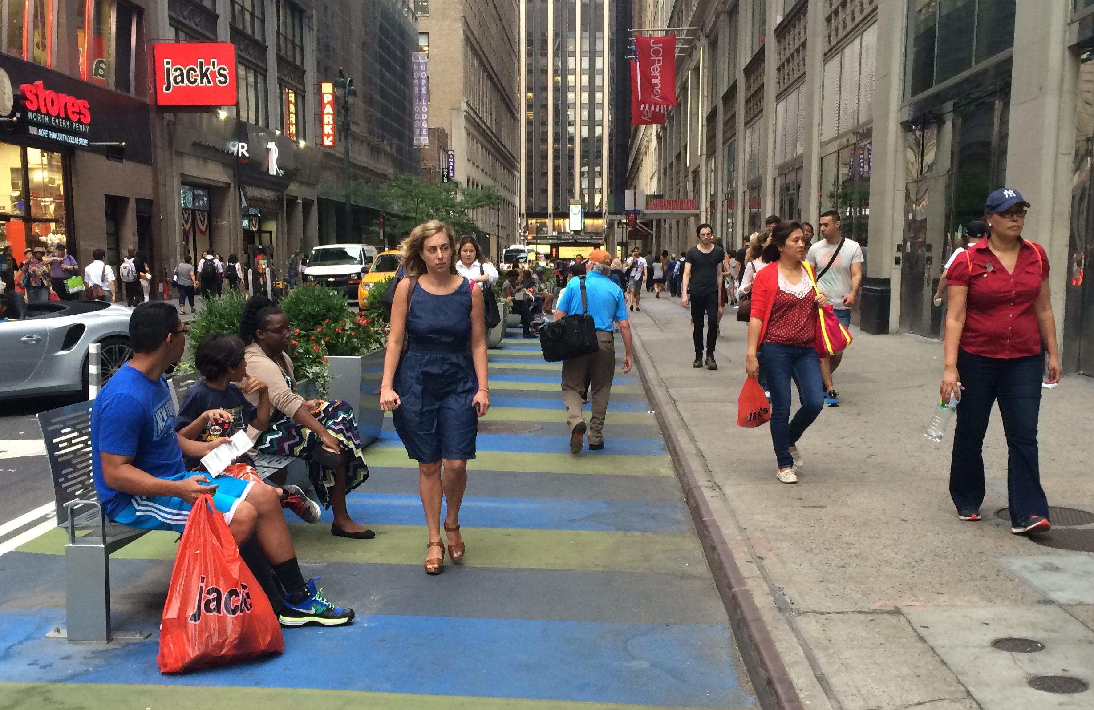
Problem statement
Human pose estimation from surveillance video.
Up-right,
front pose
Up-right,
back pose
Sitting,
side pose
https://nyc.streetsblog.org/2015/09/01/wider-32nd-street-sidewalk-could-be-erased-to-bring-back-loading-zones/

Slide 3
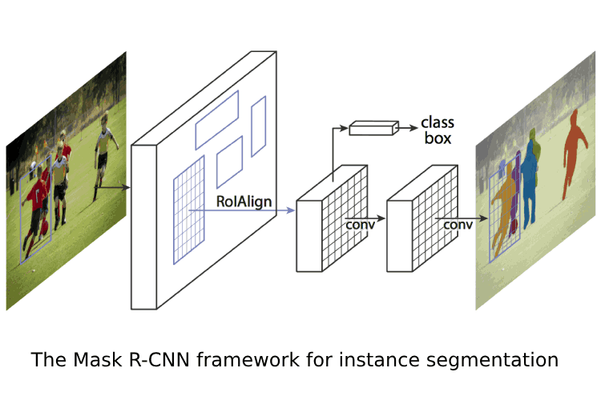
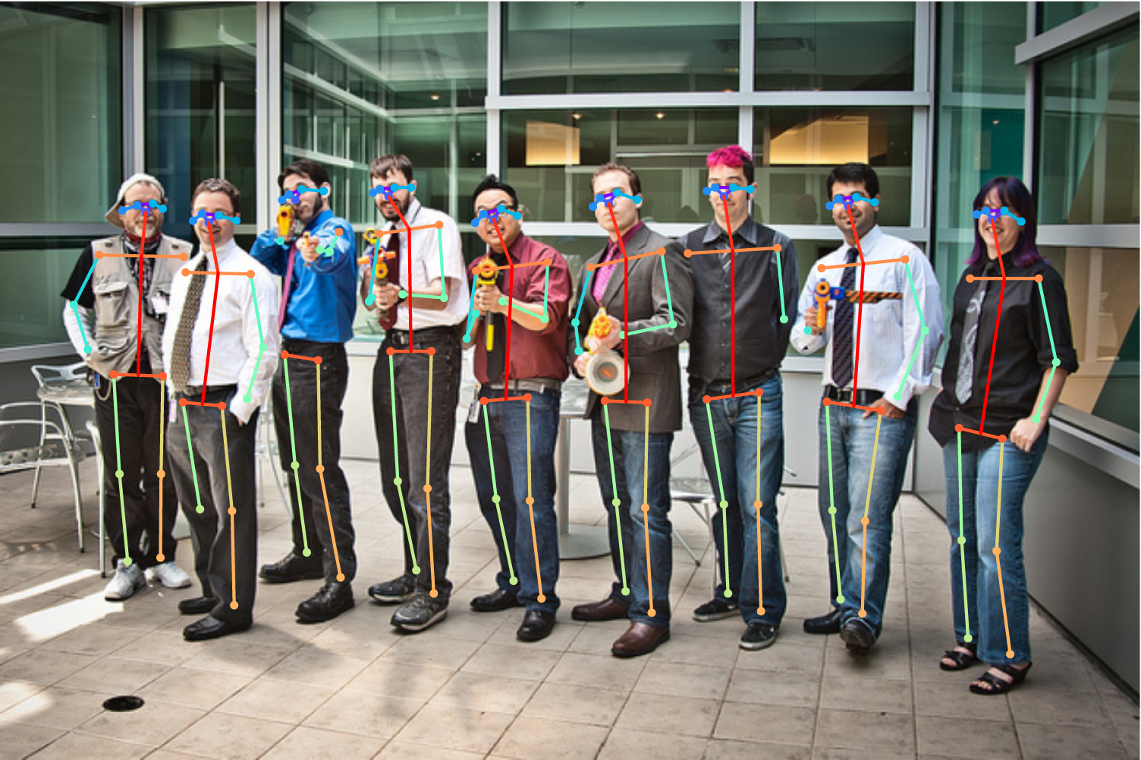
Mask R-CNN [1]
Keypoint location = 1-hot mask
Human pose = 17 keypoints
Represents pose as 17 masks
Mask R-CNN to predict K masks, one for each of K keypoint types
Mask R-CNN extends Faster R-CNN.
A branch for predicting an object mask.
ROI Alignment
K. He, G. Gkioxari, P. Dollár, and R. Girshick. Mask RCNN. In IEEE International Conference on Computer Vision (ICCV), 2017, Oct 22, pp. 2980 – 2988.

Slide 4
Detect and Track [2]
Dataset used : PoseTrack Dataset
Two stage approach for pose tracking
Spatiotemporal pose estimation over clips
Top down key count estimation using Mask R-CNN
Key points detected by 3D ResNet Model, then fed to shallow network
Uses 3D R-CNN for improved efficiency to occlusion
Linking key point predictions
Key points are linked in successive frames using the LSTM model
Likelihood distance based metric
Accuracy : 51.8%
2. Girdhar R, Gkioxari G, Torresani L, Paluri M, Tran D. Detect-and-Track: Efficient Pose Estimation in Videos. InProceedings of the IEEE Conference on Computer Vision and Pattern Recognition 2018 (pp. 350-359).

Slide 5
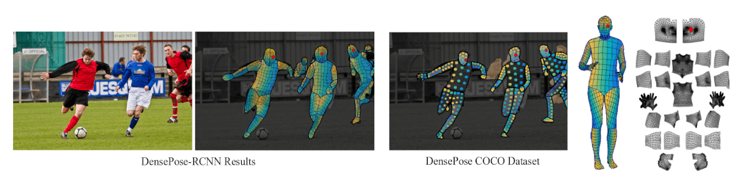
Dense Pose [3]
-In Dense pose estimation, it maps all human pixels of an RGB image to the 3D surface of the human body.
-Left: The image and the regressed correspondence by DensePose-RCNN, Middle: DensePose COCO Dataset annotations, Right: Partitioning and UV parametrization of the body surface.
-It divides the image into 24 parts in the UV parameterization.
-Each part is represented using maximum of 14 keypoints depending of the size of image.
3. Güler RA, Neverova N, Kokkinos I. Densepose: Dense human pose estimation in the wild. arXiv preprint arXiv:1802.00434. 2018 Feb 1.

Slide 6
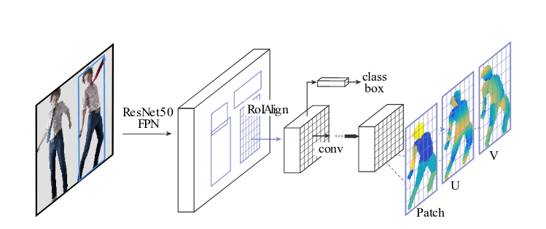
Dense Pose [3]
Training a deep network that predicts dense correspondence between image pixels and surface coordinates.
•Combining the Mask-RCNN network within a DenseReg (Dense Regression System) to obtain the correspondences between the RGB image and a 3D body surface model.

Slide 7
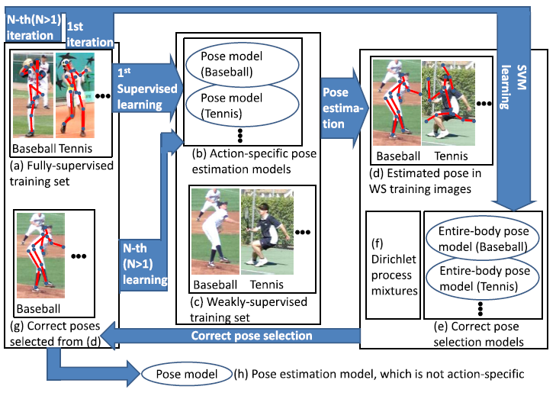
Semi- and weakly-supervised human pose estimation [4]
DATASET used
LSP, LSP extended (Johnson and Everingham, 2010) and MPII human pose
Further for performance gain of COCO 2016 key point challenge dataset is used
Ukita N, Uematsu Y. Semi-and weakly-supervised human pose estimation. Computer Vision and Image Understanding. 2018 May 1;170:67-78.

Slide 8
WPAL [5]
-Weakly-supervised Learning of Mid-level Features for Pedestrian Attribute Recognition and Localization
-Dataset used : RAP and PETA
Method :
GoogLeNet model pretrained on ImageNet used.
Firstly a set of mid-level attribute-relevant features discovered, and then attributes based of the response of these features predicted.
The activation maps of these features can be used to infer the location and rough shape of an attribute.
Accuracy :
RAP : 78.80%
PETA : 83.40 %
5. Yu K, Leng B, Zhang Z, Li D, Huang K. Weakly-supervised learning of mid-level features for pedestrian attribute recognition and localization. arXiv preprint arXiv:1611.05603. 2016 Nov 17.

Slide 9
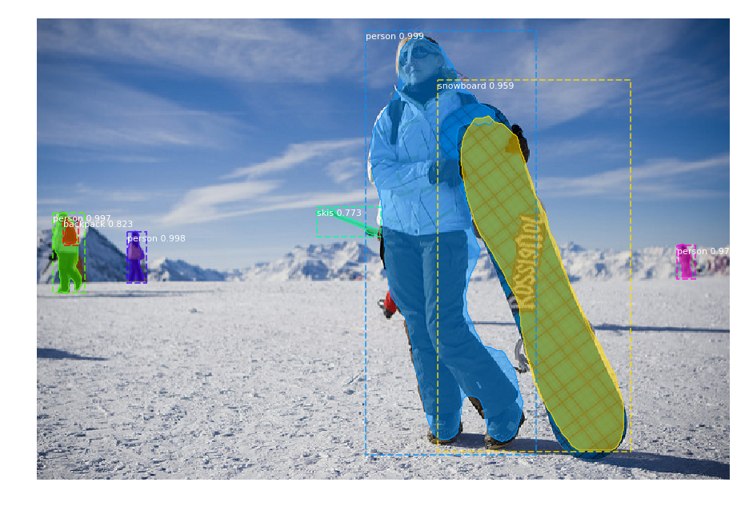
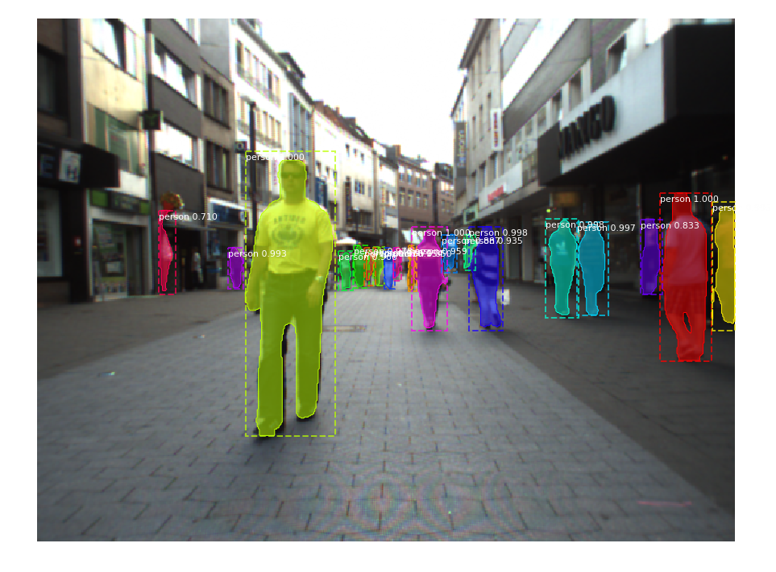
Mask R-CNN results

Slide 10
Work distribution
Mask R-CNN | Jeet, Priya, Hiren
Semi / weak supervision | Harshil, Vishwa, Hiren
Documentation (Report + Presentation) | Harshil, Vishwa, Jeet, Priya, Hiren

Slide 11
REFERENCES
[1] K. He, G. Gkioxari, P. Dollár, and R. Girshick. Mask RCNN. In IEEE International Conference on Computer Vision (ICCV), 2017, Oct 22, pp. 2980 – 2988.
[2] Girdhar R, Gkioxari G, Torresani L, Paluri M, Tran D. Detect-and-Track: Efficient Pose Estimation in Videos. InProceedings of the IEEE Conference on Computer Vision and Pattern Recognition 2018 (pp. 350-359).
[3] Güler RA, Neverova N, Kokkinos I. Densepose: Dense human pose estimation in the wild. arXiv preprint arXiv:1802.00434. 2018 Feb 1.
[4] Ukita N, Uematsu Y. Semi-and weakly-supervised human pose estimation. Computer Vision and Image Understanding. 2018 May 1;170:67-78.
[5] Yu K, Leng B, Zhang Z, Li D, Huang K. Weakly-supervised learning of mid-level features for pedestrian attribute recognition and localization. arXiv preprint arXiv:1611.05603. 2016 Nov 17.

Slide 12
Thank You

